Slide 1
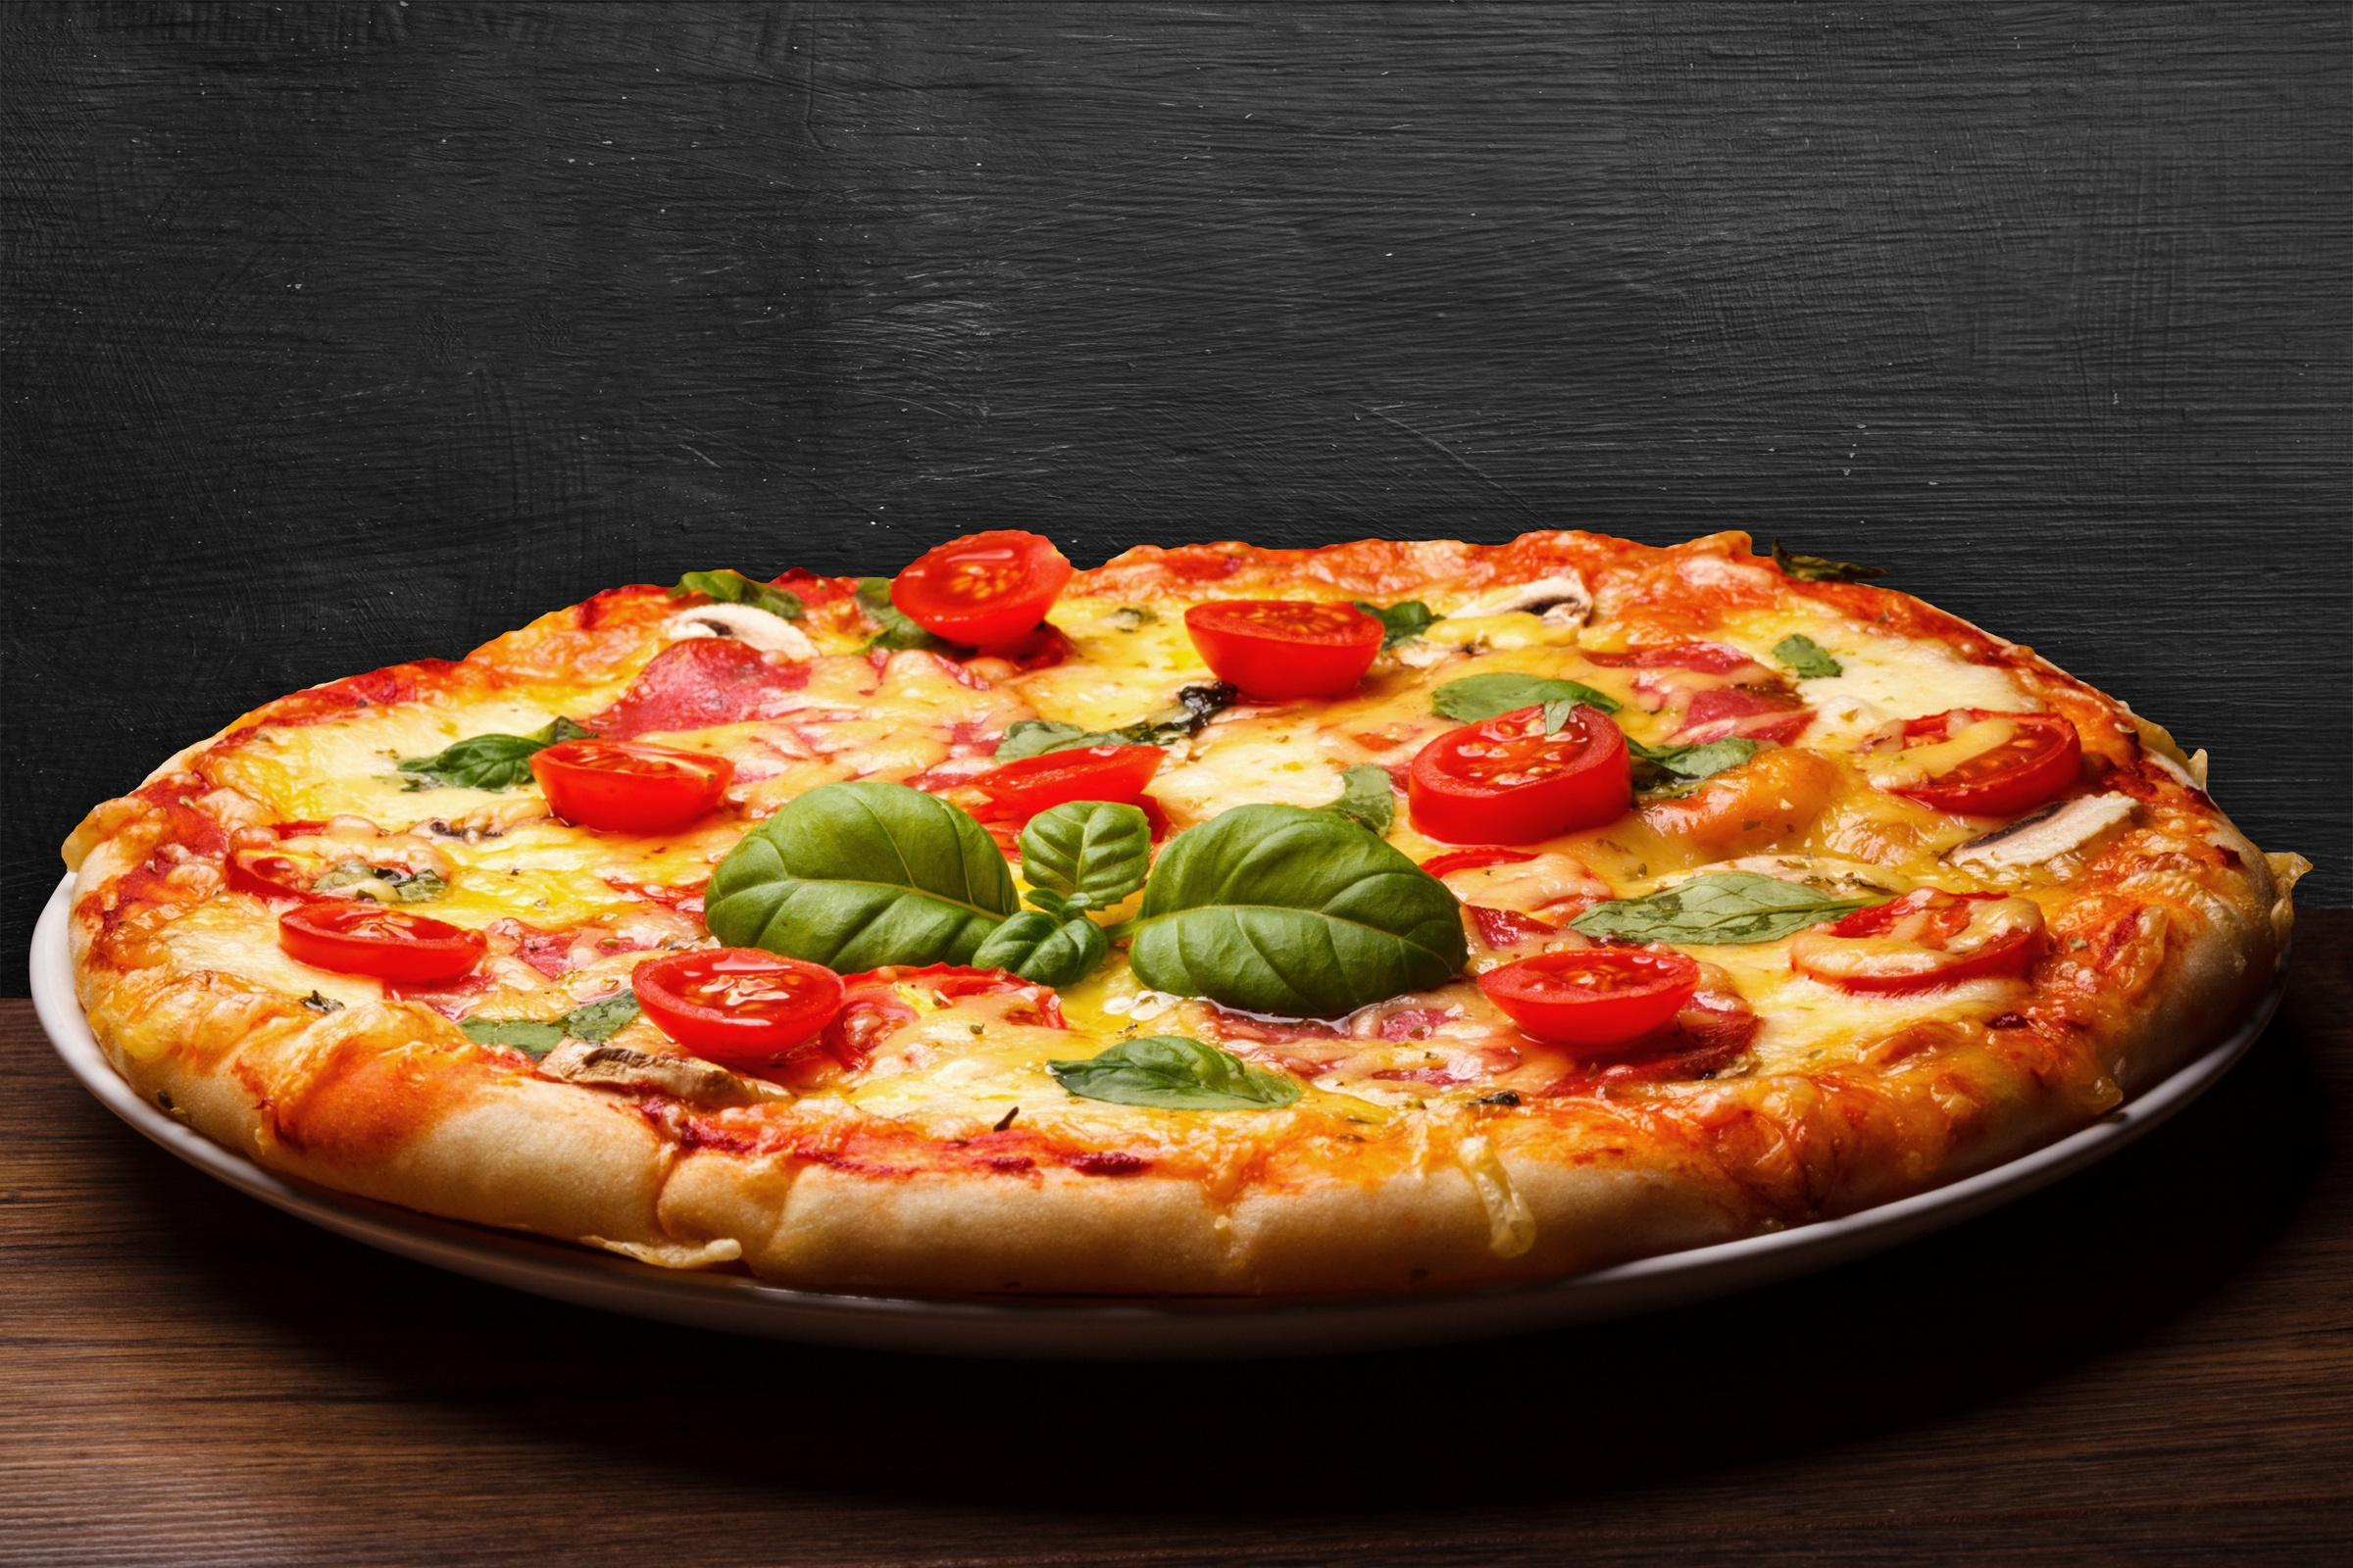

SQL project presentation
presented By: Bindu

Slide 2


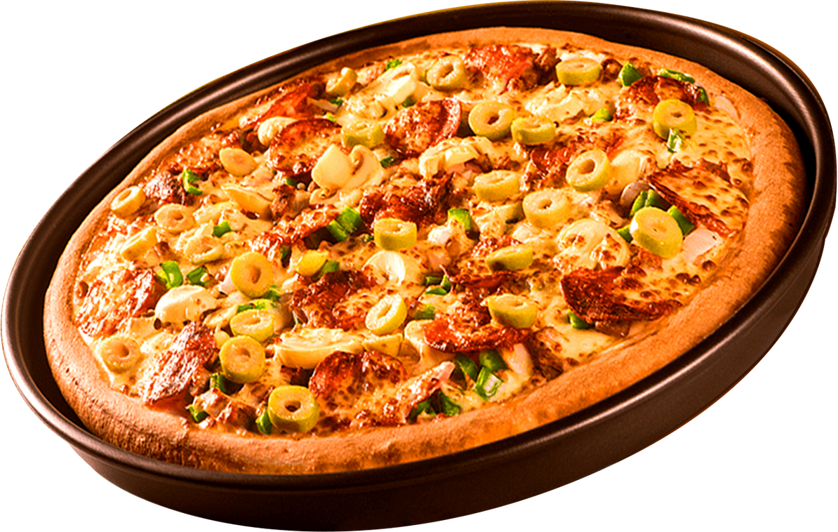

pizza HUT
welcome to
PIZZA HUT
Delicious Pizza for Everyone!!

Slide 3


PIZZA HUT
HEllo!
My name is Bindu. In this project, I have utilized SQL queries to solve few questions that were related to Pizza sales. To know all SQL Queries, please click the next slide.

Slide 4
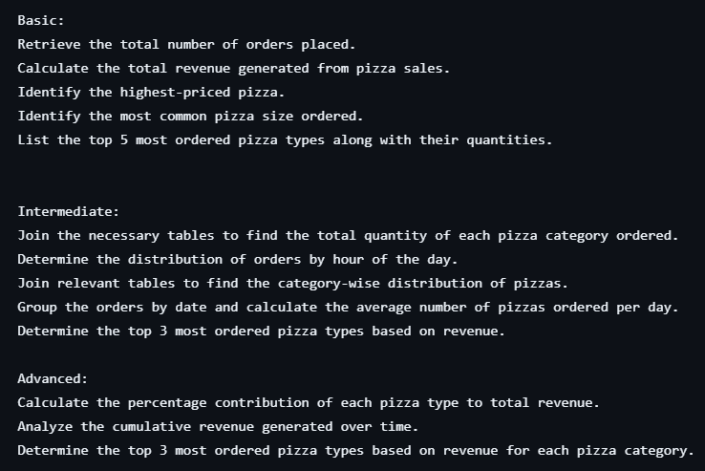
pizza HUT
Questions

Slide 5
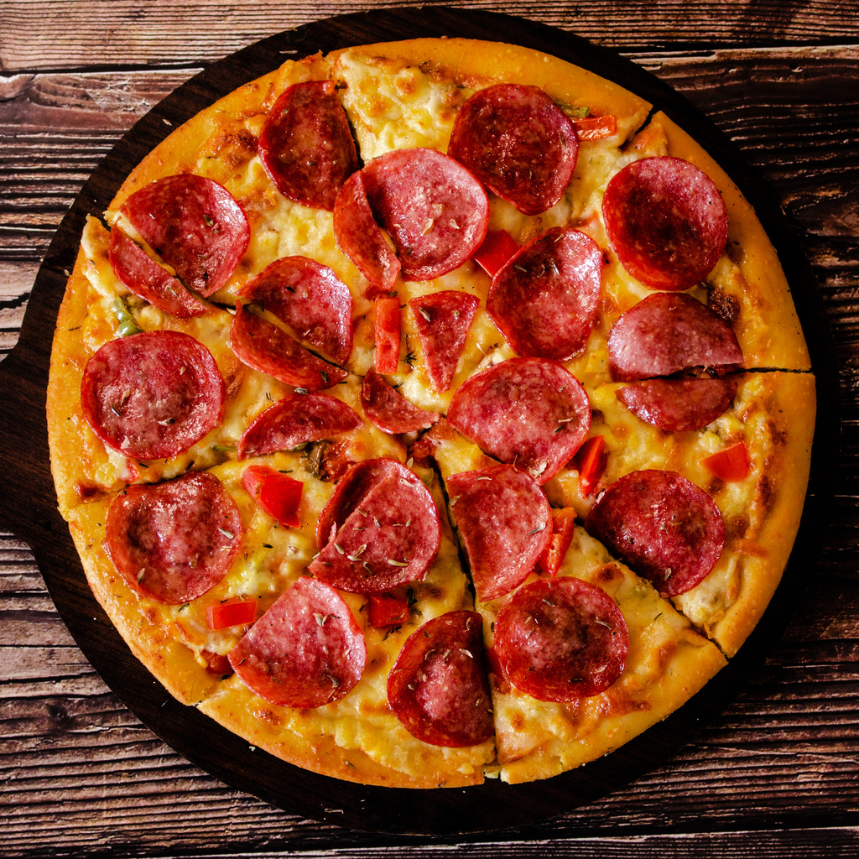



pizza hut
TOOLS USED
$6
$6
MYSQL workbench
$6
$6

Slide 6
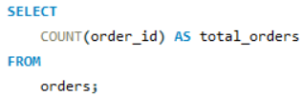
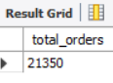
pizza hut
RETRIEVE THE TOTAL NUMBER OF ORDERS PLACED.

Slide 7
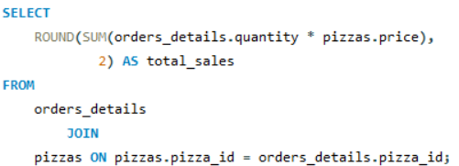
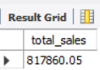
pizza hut
CALCULATE THE TOTAL REVENUE GENERATED FROM PIZZA SALES.

Slide 8
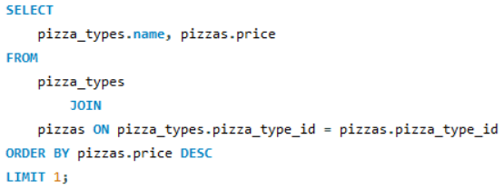
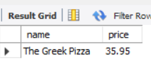
pizza hut
IDENTIFY THE HIGHEST-PRICED PIZZA.

Slide 9
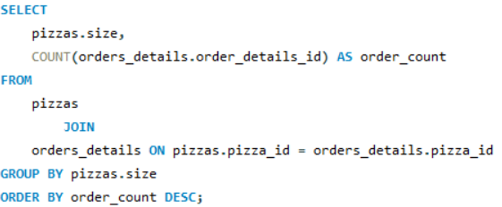
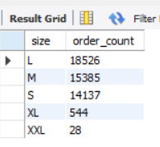
pizza hut
IDENTIFY THE MOST COMMON PIZZA SIZE ORDERED.

Slide 10
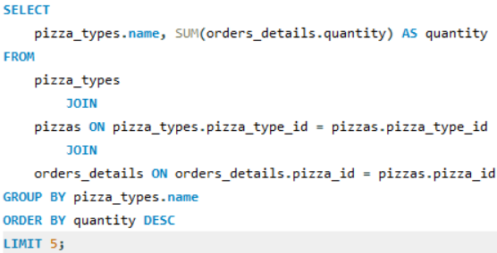
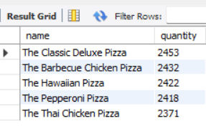
pizza hut
LIST THE TOP 5 MOST ORDERED PIZZA TYPES ALONG WITH THEIR QUANTITIES.

Slide 11
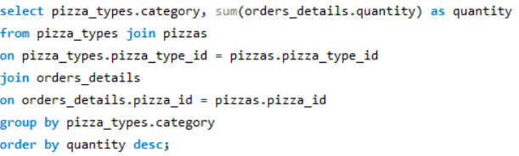
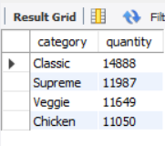
pizza hut
JOIN THE NECESSARY TABLES TO FIND THE TOTAL QUANTITY OF EACH PIZZA CATEGORY ORDERED.

Slide 12
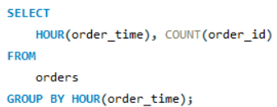
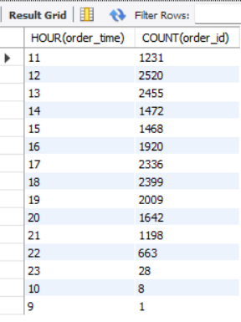
pizza hut
DETERMINE THE DISTRIBUTION OF ORDERS BY HOUR OF THE DAY.

Slide 13
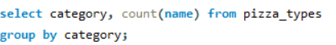
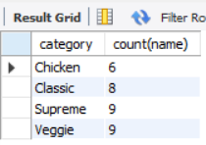
pizza hut
JOIN RELEVANT TABLES TO FIND THE CATEGORY-WISE DISTRIBUTION OF PIZZAS.

Slide 14
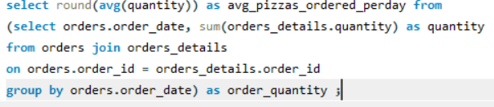
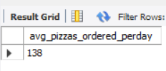
pizza hut
GROUP THE ORDERS BY DATE AND CALCULATE THE AVERAGE NUMBER OF PIZZAS ORDERED PER DAY.

Slide 15
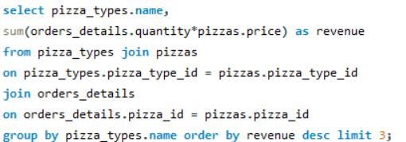
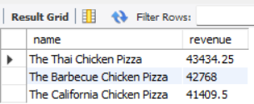
pizza hut
DETERMINE THE TOP 3 MOST ORDERED PIZZA TYPES BASED ON REVENUE.

Slide 16
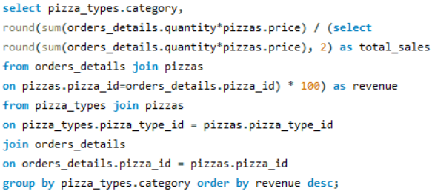
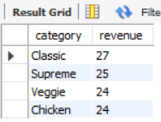
pizza hut
CALCULATE THE PERCENTAGE CONTRIBUTION OF EACH PIZZA TYPE TO TOTAL REVENUE.

Slide 17
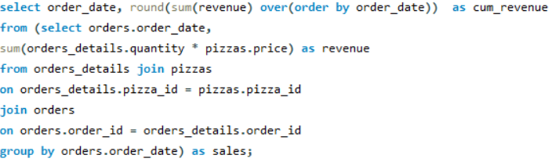
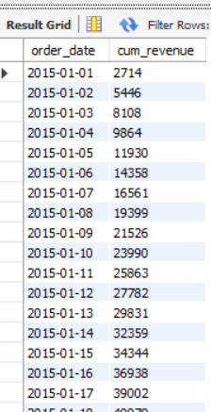
pizza hut
ANALYZE THE CUMULATIVE REVENUE GENERATED OVER TIME.

Slide 18
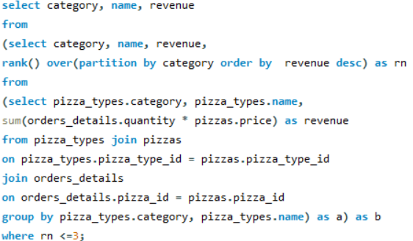
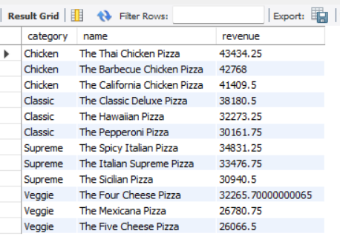
pizza hut
DETERMINE THE TOP 3 MOST ORDERED PIZZA TYPES BASED ON REVENUE FOR EACH PIZZA CATEGORY.

Slide 19




pizza hut
contact
+91 9502651497
https://github.com/Bindu1724
Hyderabd

Slide 20
pizza hut
thank you!

